Slide 1
TITLE:SECURE DATA Hiding in images using steganography
CAPSTONE PROJECT
Presented By: U. RAJESH
Student Name : U. RAJESH
College Name & Department : Institute of Aeronautical Engineering, CSE(Cyber Security)

Slide 2
OUTLINE
Problem Statement
Technology used
Wow factor
End users
Result
Conclusion
Git-hub Link
Future scope

Slide 3
Problem Statement
With the increasing need for secure communication, traditional encryption methods often attract attention, making data vulnerable to interception. This project aims to conceal sensitive information within images using steganography, ensuring that the existence of the hidden data remains undetectable to unauthorized users.

Slide 4
Technology used
Programming Language: Python
Libraries:
OpenCV (cv2) – for image processing
OS module – for file handling
Concept: Image-based steganography
Methodology: Encoding and decoding messages by manipulating pixel values in an image
Operating System: Windows
Development Platform: VS Code
Version Control: GitHub – for code hosting and collaboration
Deployment: GitHub repository

Slide 5
Wow factors
Invisible Communication:
Messages remain undetectable in images.
Passcode Protection:
Only authorized users can retrieve hidden messages.
Minimal Image Distortion:
Ensures the integrity of the original image.
User-Friendly Implementation:
Simple encryption and decryption with minimal computational overhead.
Practical Applications:
Secure message transfer, watermarking, and digital forensics.

Slide 6
End users
Government Agencies: Secure transmission of classified data.
Journalists & Whistleblowers: Safeguard confidential information.
Cybersecurity Experts: Protect sensitive credentials.
Individuals: Personal data protection against cyber threats.

Slide 7
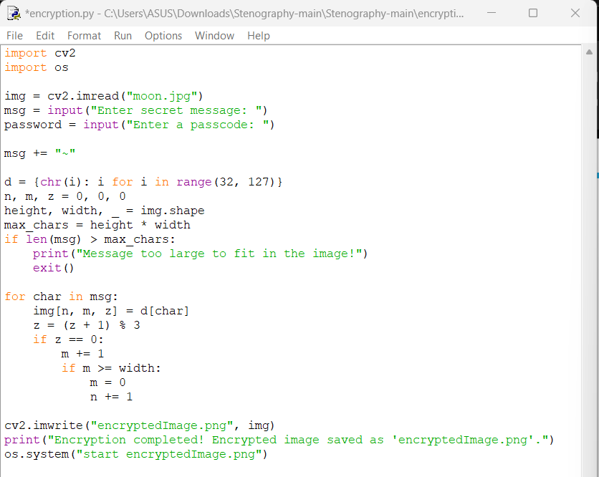
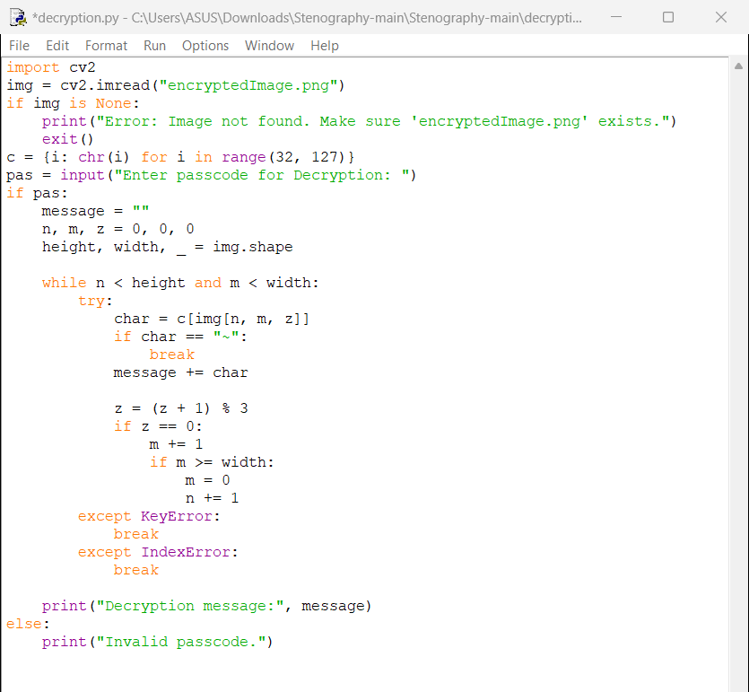
Results

Slide 8
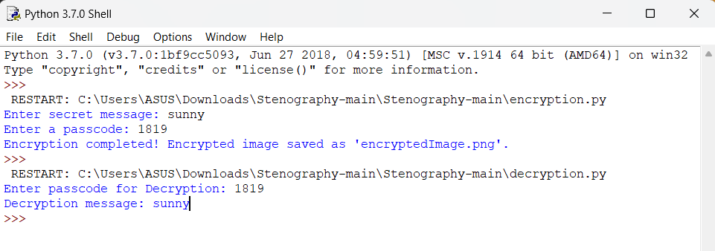
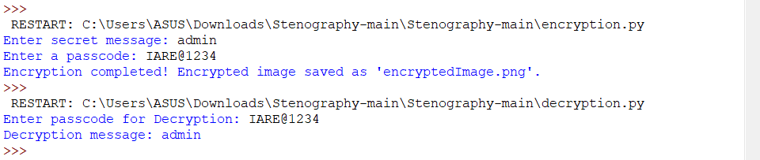
Results

Slide 9
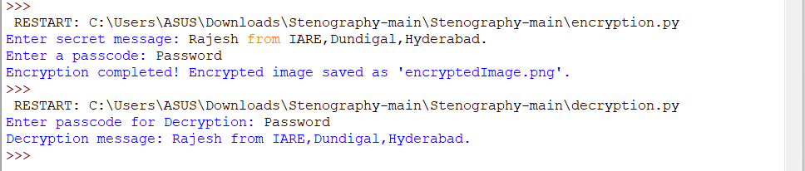
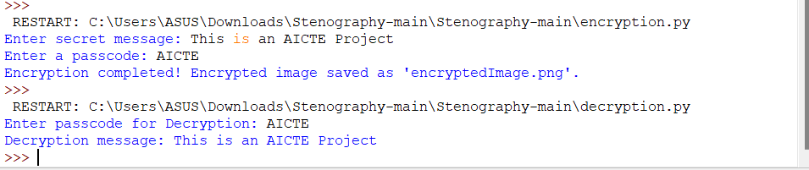
Results

Slide 10
Conclusion
Steganography provides an effective and covert method of secure communication. Unlike traditional encryption, it does not attract unwanted attention. The implementation of this technique using Python and OpenCV showcases its feasibility, security, and practicality in modern cybersecurity and data protection.
Steganography provides an effective and covert method of secure communication. Unlike traditional encryption, it does not attract unwanted attention.
The implementation of this technique using Python and OpenCV showcases its feasibility, security, and practicality in modern cybersecurity and data protection.

Slide 11
GitHub Link
https://github.com/rajesh-1819/steganography-aicte.git

Slide 12
Future scope(optional)
AI-Powered Steganography: Enhance security by making detection even more challenging.
Multi-Layer Encryption: Combine steganography with cryptographic techniques for double security.
Video & Audio Steganography: Extend the concept beyond images.
Cloud-Based Steganography: Secure cloud communications with embedded messages.
Mobile App Integration: Implement for Android/iOS for real-world use.

Slide 13
THANK YOU

